Slide 1
Transport Layer – Part I Chapter 3
Part I
1. Transport Service
2. Elements of Transport Protocols
Part II
3. Internet Protocols – UDP
4. Internet Protocols – TCP
Notes:
In this chapter, we will see TCP and UDP, two primary transport layer protocols, as well as socket programming.

Slide 2
1. Transport Service
Services Provided to the Upper Layer »
Transport Service Primitives »
Berkeley Sockets »
Socket Example: Internet File Server »
Notes:
In transport service, we will look at the services provided to the upper layer, Berkeley Sockets, and its programming example.

Slide 3
Services Provided to the Upper Layers (1)
The goal of the transport layer is to provide efficient, reliable, and cost-effective data transmission service to its users – programs in the app-layer
To achieve this, the transport layer makes use of the services provided by the network layer
The software and/or hardware within the transport layer that does the work is called the transport entity
can be located in the OS kernel, in a library package bound into network applications, or in a separate user program

Slide 4
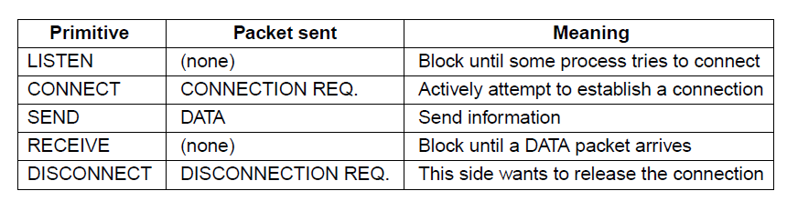
Transport Service Primitives (1)
For apps to access the transport services, the transport layer must provide some operations to the apps
Primitives that applications can call to transport data for a connection-oriented (TCP) service:
Server calls listen, receive, send, disconnect
Client calls connect, send, receive, disconnect
Segment
Notes:
There are some primitives can be called by applications in the app layer to transport data using TCP services. In a client side, the primitives Connect, Send, Receive, and Disconnect can be called. But in a server side, the available primitives are Listen, Receive, Send, and Disconnect. [Explain each primitive using the table]

Slide 5
Transport Service Primitives (2)
An example: an application with one server and a number of clients
The server executes a LISTEN primitive
a client executes a CONNECT primitive, and a CONNECTION REQUEST segment is sent to server
server sends a CONNECTION ACCEPTED segment back to the client (connection established)
Data can now be exchanged using the SEND and RECEIVE primitives from both sides
a connection is released when both sides call a DISCONNECT primitive

Slide 6
2. Elements of Transport Protocols
Addressing »
Connection establishment »
Connection release »
Error control and flow control »
Notes:
Let’s discuss the elements in Transport protocols. We will look at how to address a node, how to set up/release a connection, how to detect error and control flow, and how to share one NIC interface by multiple processes.

Slide 7
Addressing at the trans-layer
When an app wishes to set up a connection to another app running on a remote host, it must specify which one to connect to
The method normally used is to define transport addresses to which apps can listen for connection requests
On the Internet, these endpoints are called ports (or port numbers)
The term TSAP (Transport Service Access Point) is used to mean a specific endpoint in the transport layer
Notes:
A Transport Services Access Point (TSAP) is an end-point of data communication between the Transport layer (layer 4) and the Application layer (layer 5).
TSAPs are ports for TCP/UDP. It also means that
each running application process is addressed by a port number, and
each host in network communication is addressed by IP.
[Explain the communication between Host 1 and Host 2 using the diagram in the slide]

Slide 8
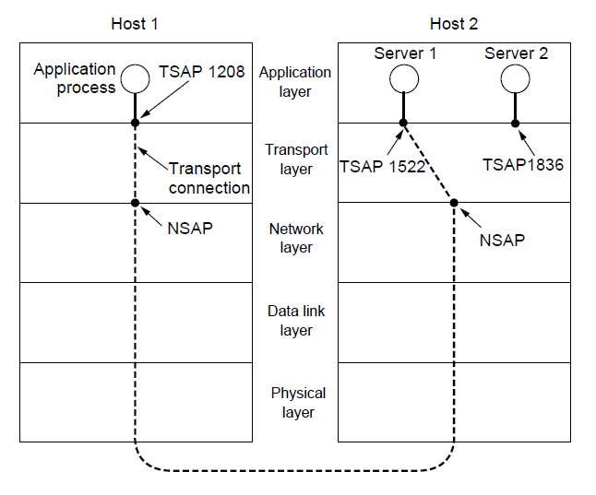
Transport Service Access Point
A TSAP is an end-point of data communication between the Transport layer (layer 4) and the App layer (layer 5)
Each running application is addressed by a port number (or TSAP)
Notes:
A Transport Services Access Point (TSAP) is an end-point for communication between the Transport layer (layer 4) and the Application layer (layer 5). TSAPs are ports for TCP/UDP, it also means each running application process is addressed by a port number, and each host/node in network communication is addressed by IP. [Explain the communication between Host 1 and Host 2 using the diagram in the slide]

Slide 9
Default ports using by applications
HTTP Web server: 80
HTTPS Web server: 443
SSH: 22
FTP server: 20/21
SMTP server: 25

Slide 10
Connection Establishment
To establish a connection, it would seem sufficient for a client to send a CONNECTION REQUEST to the server and wait for acceptance
The problem occurs when the network may lose, delay, corrupt, and duplicate packets
This behavior causes serious complications
The key problem is to ensure reliability even though packets may be lost, corrupted, delayed, or duplicated

Slide 11
Approach to ensure TCP reliability
The TCP 3-way handshake is used for establishing a connection
Uses ARQ (Automatic Repeat reQuest) and checksums to handle packet loss/corruption
ARQ is an error control method used to achieve reliable data transmission by using error-detection codes, ack or negative-ack messages, and timeouts
Old or duplicated packets can be identified by packet sequence numbers
Notes:
Automatic Repeat reQuest (ARQ) is an error control method for data transmission that makes use of error-detection codes, acknowledgment and/or negative acknowledgment messages, and timeouts to achieve reliable data transmission.
An Acknowledgement (ACK) or Negative Acknowledgement (NACK) is a short message sent by the receiver to the transmitter to indicate whether it has correctly or incorrectly received a data packet, respectively.

Slide 12
Sequence and Acknowledgement numbers
TCP is a byte-oriented protocol
the sender writes bytes into a TCP connection and the receiver reads bytes out of the TCP connection
A sequence number identifies a TCP segment’s place (byte #) in the sequence of the byte stream
used to keep track of how many bytes of data the sender has transmitted
An acknowledgement number is used by the receiver to inform the sender that the data up to which byte (byte #) has been successfully received

Slide 13
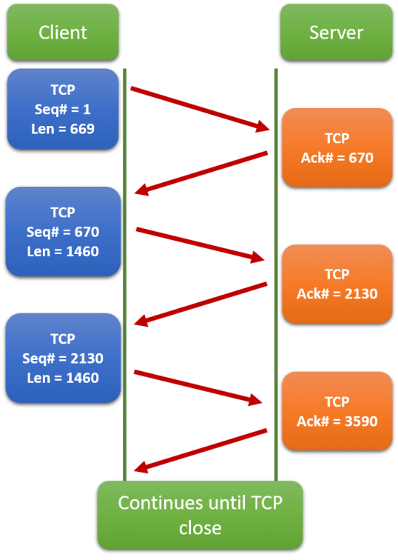

Slide 14
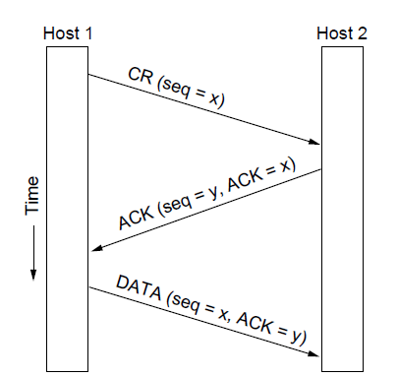
TCP Three-way Handshake (1)
CR: Connection Request
Step 1
Host 1 sends a CR segment (SYN) containing its initial sequence number x to Host 2

Slide 15
TCP Three-way Handshake (2)
Step 2
When Host 2 receives the CR, it checks its own resources to decide whether it will accept or reject the request
If accept (SYN/ACK), Host 2 replies with an ACK segment of (seq = y, ACK = x)
Announcing its own initial sequence number y
Indicating up to byte x successfully received
Otherwise, an RST is sent
Connection Request
Notes:
If Host 2 found it does not have enough resources, such as CPU, Memory, or some other limits, it will reject the request from Host 1. If Host 2 accepts the CR, it will acknowledge Host 1 with seq =y, and ACK = x. This indicates that it accepts the sequence number x used by Host 1, and also tells Host 1 that Host 2 will use y as initial sequence number.

Slide 16
TCP Three-way Handshake (3)
Step 3
Assuming Host 1 receives an ACK response from Host 2, it acknowledges host 2’s choice of the initial sequence number y in the first data segment that to be sent
The connection is then established successfully
Host 1 can either ACK Host 2 only, or carry some data in the last ACK (shown in this diagram)
Notes:
As soon as Host 1 receives the Acknowledgement response from Host 2, it acknowledges Host 2, and the connection is established successfully. Host 1 can either acknowledge Host 2 only, or carry some data in the last ACK, just as shown in this diagram.

Slide 17
Review Questions
What is the responsibility of the transport layer?
What are the services of the transport layer provided to the upper layers?
What are the transport-layer primitives that applications can call to transport data for a connection-oriented (TCP) service?
What is a socket? What are the socket primitives?
What are the basic steps of a socket server program? What are the basic steps of a socket client program?
When an app wishes to set up a connection to another app running on a remote host, how does it know which one to connect to?
How does an application at the app-layer access the services implemented at the trans-layer?

Slide 18
More Review Questions
What are the default port numbers used by HTTP, HTTPS, SSH and FTP, respectively?
What are the approaches used by TCP to ensure reliability?
What is a TCP sequence number? What is an acknowledgement number? What are they used for?
How does TCP Three-way Handshake work?

